Slide 1


PASSIVE INVESTING:
A DEBRIFING AND GUIDE
Notes:
Hello
Title
Subtitle
Based on

Slide 2
Introduction
Saving resources and investing is important for people and families in order to achieve their goals
There are a plenty of information available today about investments
Which sometimes makes people confused, and become a barrier for the subject
Investing is complicated and there are many ways to do it
Manage your money by yourself
Contract services to do it for you
A lot of investor decide to give their money for institutions investing for them, but they charges high fees, and many academic studies have shown that institutions usually do not perform better than the market
This presentation aims to give a solution for this problem by Investing Passively
Notes:
Title
Saving
Information
How invest
Institutions
AIm

Slide 3
Main topics about Returns
According with David Swensen (2011), these three are the most important aspects that affect returns.
Security Selection
Choosing the specific securities.
Market Timing
Choosing the assets to hold given a long run situation that you believe and that does not match with the short run situation.
Asset Allocation
The return achieved by the combination of different securities, with different correlations.
Notes:
David Swensens is a important name when talking about investments
He was responsible for the yale endowsenment fund
Security Selection
Market Timing
Asset Allocation

Slide 4
Active Investing
The goal of active investing:
Performing better than the market
How it is done:
Security Selection, you give a value for a security different from the market, and you invest based on it.
Market timing, you believe that the price is not reflecting all the future information, and invest based on when the price will reflect the long run situation that you are forecasting.
Asset Allocation, relying heavily in statistics and math, they try to match the assets in the most efficient way.
Notes:
Goal
How it is done

Slide 5
Why investing passively
Ass you saw, it is now easy to invest actively, and it is probably not something that you can do individually. This makes most people giving their money for institutions to manage their money.
But there are three main problems about investing in mutual funds:
Choosing a good mutual fund is so difficult as choosing the best securities
These services are expensive
Studies have shown that investment institutions usually cannot “beat the market”, and even when they do so, they are uncapable to keep it. This due to the efficient market hypothesis (Bhattacharya & Galpin, 2011).
So the best thing to do, would be holding the market itself, and think more about your portfolio allocation.
Notes:
Investing actively is not possible for individuals
Active funds
Main problems (3)
Efficient Market Hypothesis
Holding the market as a solution

Slide 6
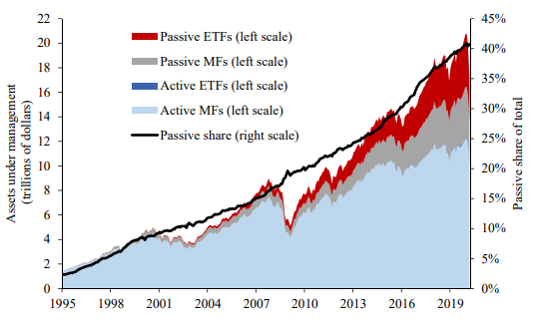
The new trend of Passive investing
We can see that passive investing has been Increasing its market share in the Financial
Market, and people are starting to adopt more it.
Anadu, Kruttli, McCabe, & Osambela, Figure 1: Total assets in active
and passive MFs and ETFs and passive share of total, 2020
Notes:
Passive investing is increasing market share

Slide 7
How to invest passively
There are many ways to invest passively. But in order to keep the content simple, lets cover the main topics about it.
Decide your level of risk
Decide the asset classes that you want to hold
Decide the weight in each one
Decide how will be the rebalancing of the weights
Notes:
Risk
Assets
Weight
Rebalancing

Slide 8
ETFs
Exchange-traded funds are a type of security that tracks an index, sector, commodity, or other asset, but which can be purchased or sold on a stock exchange the same way a regular stock can.
Example of ETFs:
ETF | Name | Segment | Fee
GLD | SPDR Gold Trust | Commodities | 0.40%
BITO | ProShares Bitcoin Strategy ETF | Currency | 0.95%
IVV | iShares Core S&P 500 ETF | Equity | 0.03%
AGG | iShares Core U.S. Aggregate Bond ETF | Fixed Income | 0.04%
TIP | iShares TIPS Bond ETF | Fixed Income | 0.19%
VWO | Vanguard FTSE Emerging Markets ETF | Equity | 0.10%
Source: https://www.etf.com/
Notes:
Explain ETFs

Slide 9
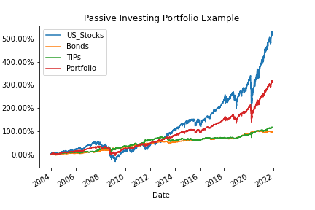
Portfolio Example
This was a portfolio that I simulated in order to give an example.
Ticker | Segment | Weight
IVV | U.S. Stocks | 50%
AGG | Fixed Income | 30%
TIP | Short Term Treasuries | 20%
Source: Yahoo Finance
The plot was made by the author
Notes:
Example portfolio
Explain how was made

Slide 10
Conclusion
Active investing is complicated, expensive and does not guarantee better results.
Passive investing is relatively simple, time and costing saving, and has a strong academic support.
By doing it you can highly diversify your risks, and yet decreasing your operational costs.
You need to define your goals, exposure assets, weights and the strategy to rebalance.
Something that is not known for many investors, is that more important than the rate of return, is how much do you save. So by keeping investing simple, you have more time working to increase your income, and to enjoy doing what you really like to do.
Notes:
Active investing is complicated and does not guarantee better results
Passive investing is money and time saving
It can be much less riskier
Risk, Assets, Weights, Rebalancing
Most important than your return, is how much you save

Slide 11
Bibliography
Anadu, K., Kruttli, M., McCabe, P., & Osambela, E. (2020). Figure 1: Total assets in active and passive MFs and ETFs and passive share of total. The Shift from Active to Passive Investing: Risks to Financial Stability? Federal Reserve of Boston.
Anadu, K., Kruttli, M., McCabe, P., Osambela, E., & Chae Hee Shin. (2018). The shift from active to passive investing: Potential risks to financial stability? U.S. Federal Reserve Board's Finance & Economic Discussion Series, 1-28.
Bhattacharya, U., & Galpin, N. (2011). The global rise of the value-weighted portfolio. Journal of Financial and Quantitative Analysis 46 (3), 737-756.
Brown, S. J. (2020). The efficient market hypothesis, the financial analysts journal, and the professional status of investment management. Financial Analysts Journal, 5-14.
Crane, A., & Crotty, K. (2018). Passive versus active fund performance: Do index funds have skill? Journal of Financial & Quantitative Analysis, 33-64.

Slide 12
Bibliography
Nazaire, G., Pacurar, M., & Sy, O. (2021). Factor investing and risk management: Is smart-beta diversification smart? In Finance Research Letters 41, 1-13.
Puelz, D., Hahn, P., & Carvalho, C. (2020). Portfolio selection for individual passive investing. Applied Stochastic Models in Business & Industry, 124-142.
Swensen, D. (2011). 6. Guest Speaker David Swensen. Fonte: https://www.youtube.com/watch?v=wRdx7kVNQ_E
Tokic, D. (2020). The passive investment bubble. Journal of Corporate Accounting & Finance (Wiley), 7-11.

Slide 13
Appendix
The Word file with contains the academic paper, the PowerPoint containing the presentation, and the figures and Python code that were used in order to develop this project are all compiled in this link on Github.
https://github.com/Gabrielmastrangelo/BCPT-123_Word_Power_Project
Notes:
All data is compiled in this link

